Slide 1




The Neuromancers’ Journey
Lessons learned from Sigma Two Connect: Rental Listing Inquiries
Carlos Salas
Analytics
Jake Bialer
Engineering
Tom Hunter
Management
Drace Zhan
Modeling

Slide 2

The Method

Slide 3
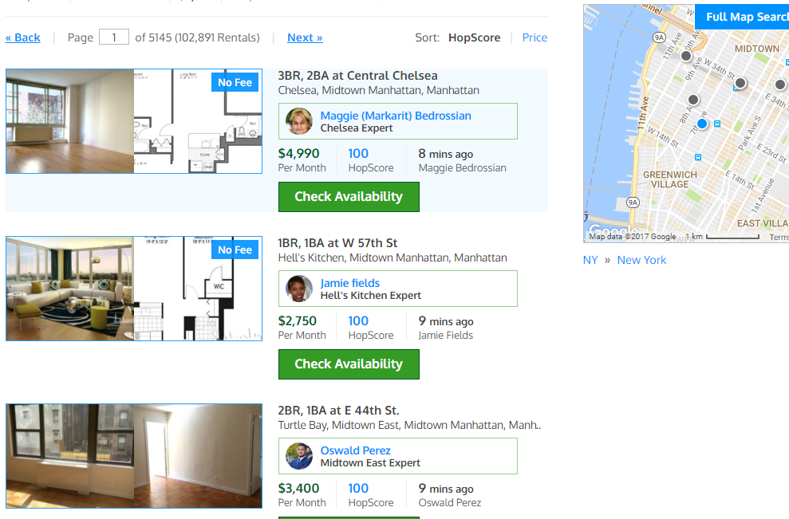
The Research
The Default ordering is by “HopScore”
Some lists will have no fees while others will have it unstated
Primary photos either include floor plans or a separate picture

Slide 4
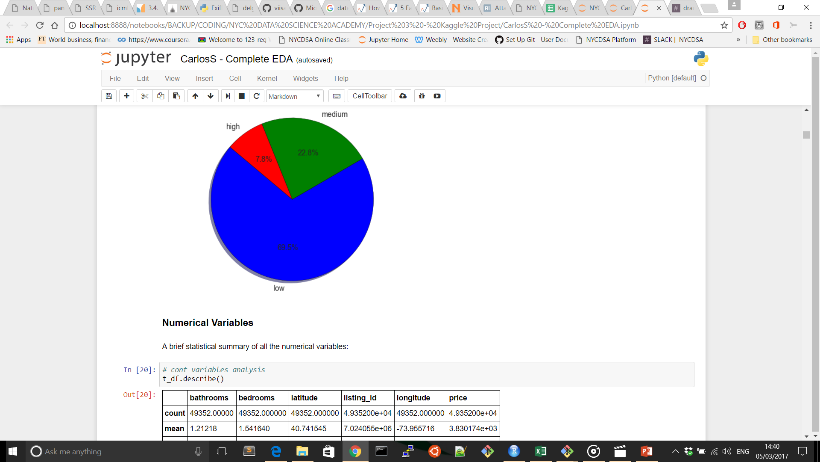
Interest Level Segmentation – Low Interest Is by far the most important class

Slide 5
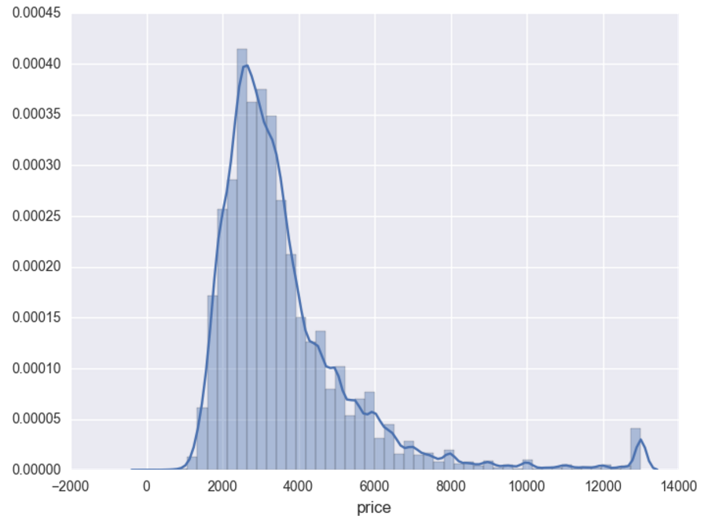
Price Histogram – Strong right skew and kurtosis – Log price transformation helped

Slide 6
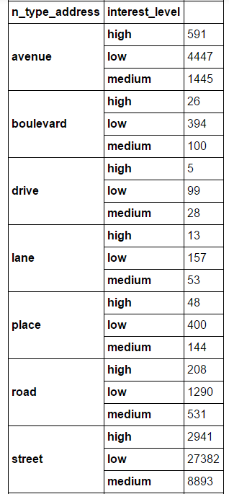
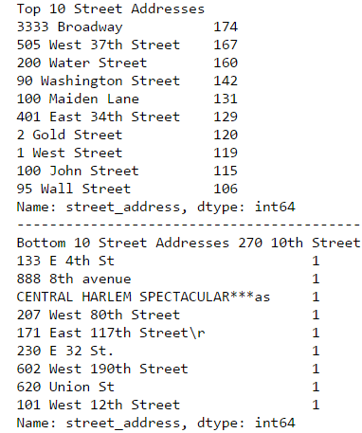
Address EDA – Address Type has no Interest, yet “Broadway” listings had some significance

Slide 7
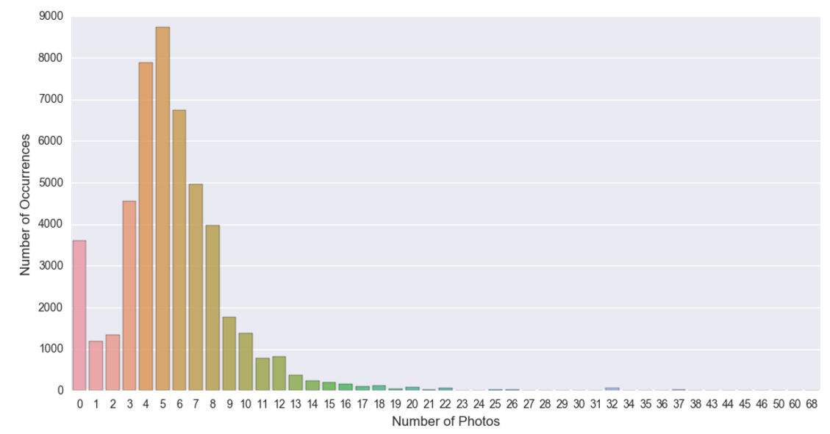
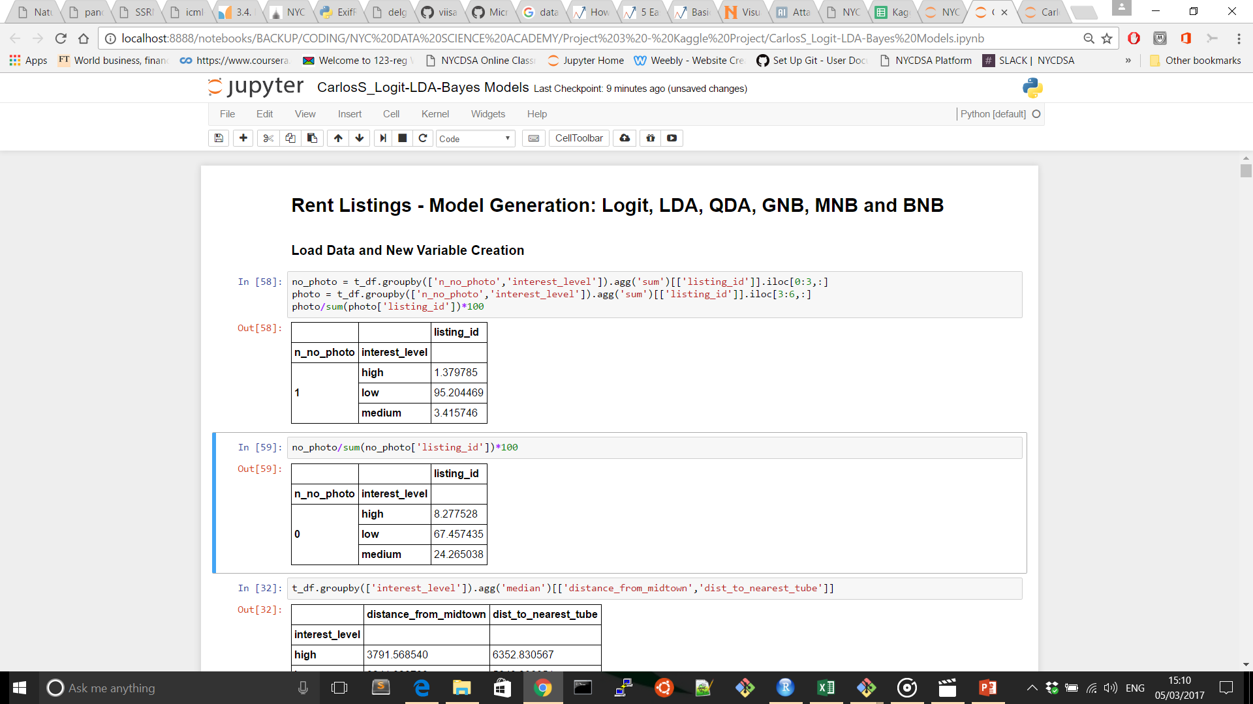
New Variables Creation – A picture is worth more than 1,000 words
Probability of low_interest occurrence is 25% lower when the listing has pictures.

Slide 8
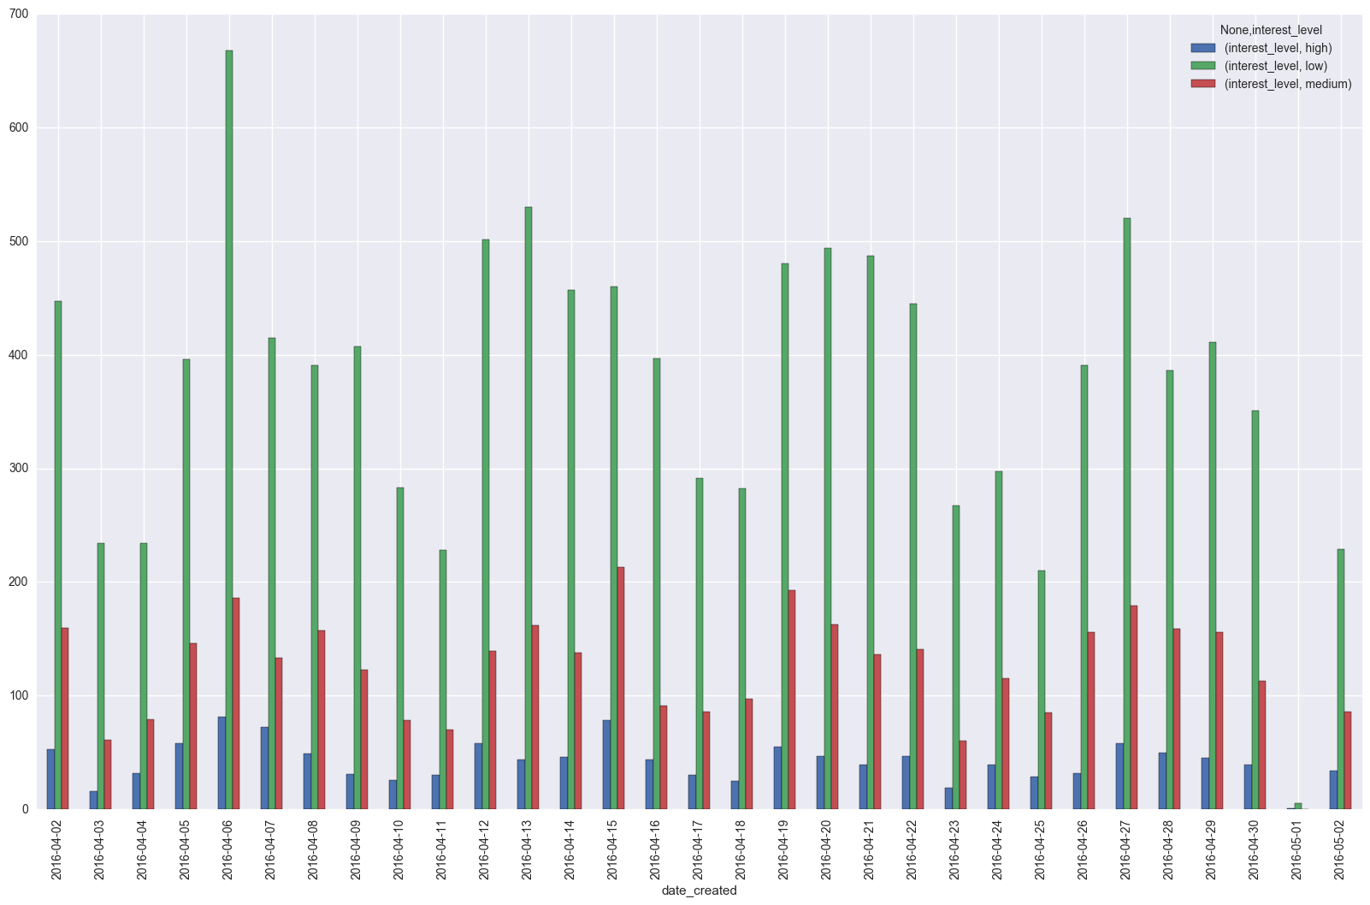
April’s Listings Interest Levels

Slide 9
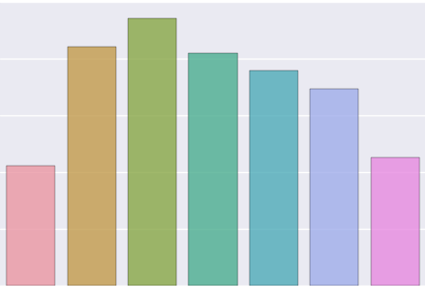
Listings Posted by Day of Week
Sunday Monday Tuesday Wednesday Thursday Friday Saturday

Slide 10
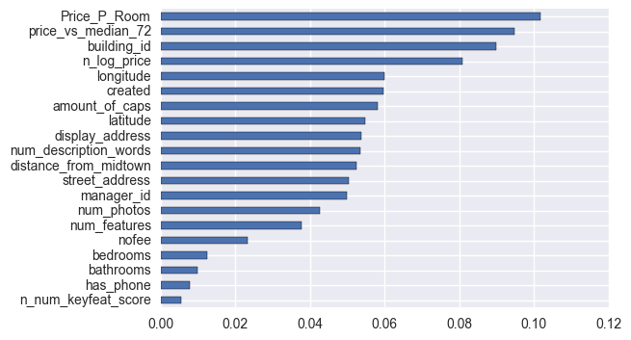
Notable Features from Basic EDA

Slide 11
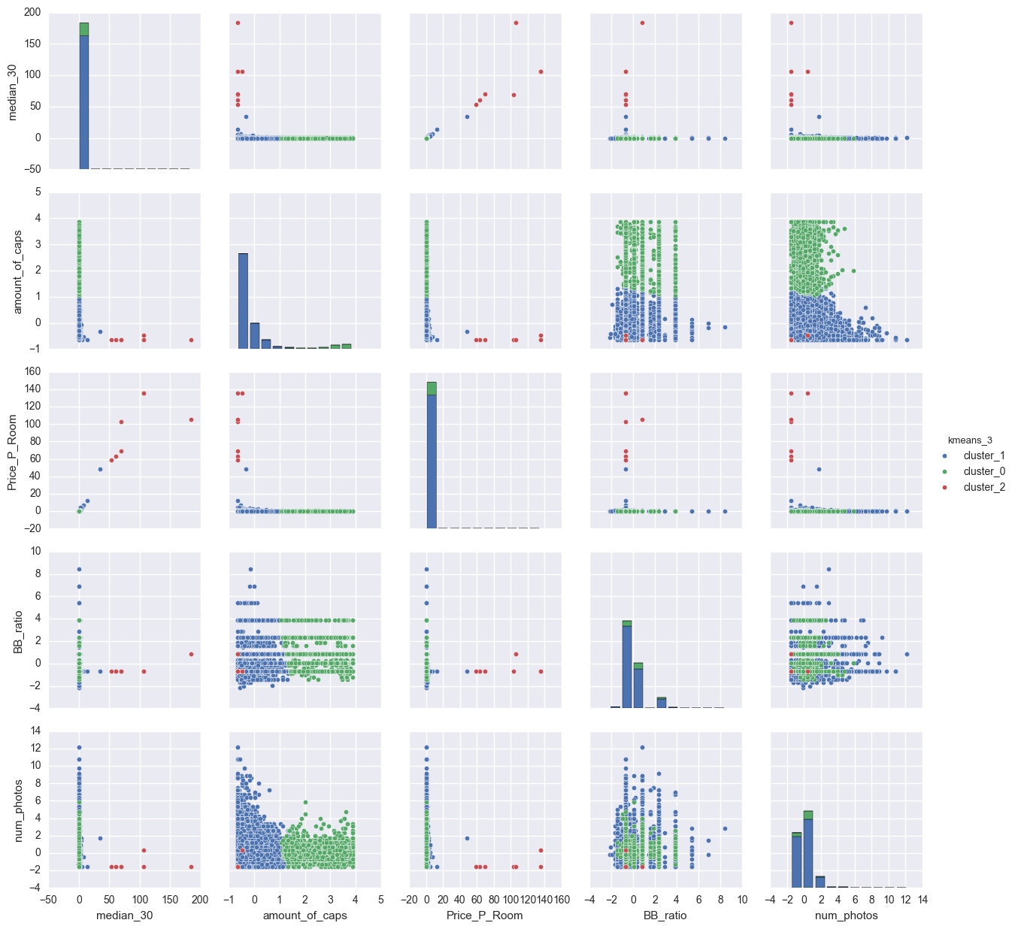
In Hindsight …
Should’ve done clustering first

Slide 12
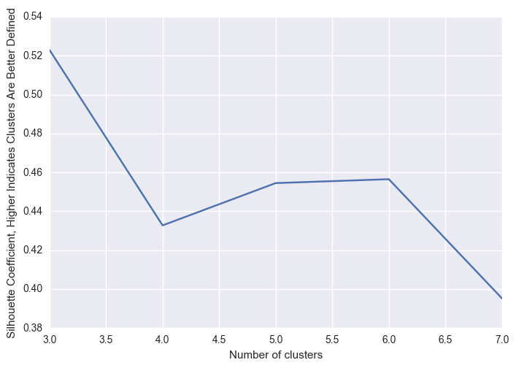
Silhouette Scoring:
How many “interest” levels really exist?
There was definitive three “interest” groups!
Don’t underestimate “The GrandDaddy of Clustering!”

Slide 13
Linear Models
Trees
Ensemble
Support Vector M

Slide 14
The Journey
Ok internal testing indicates our model is looking good! Our model was outputting log_loss of .53
Model 1 Log Loss
Random Forest 0.80080
Uh oh ...
Maybe with a bit of refinement ...
Model 2 Log Loss
Gradient Boosting 0.56300
With brute force tuning ...
Model X Log Loss
XGBoost 0.55520

Slide 15
And a thank you for joining us on our journey …
Neuromancers signing out ...

